Slide 1

Chapter 3 Querying RDF stores with SPARQL

Slide 2
TL;DR
We will want to query large RDF datasets, e.g. LOD
SPARQL is the SQL of RDF
SPARQL is a language to query and update triples in one or more triples stores
It’s key to exploiting Linked Open Data

Slide 3
Three RDF use cases
Markup web documents with semi-structured data for better understanding by search engines
Use as a data interchange language that’s more flexible and has a richer semantic schema than XML or SQL
Assemble and link large datasets and publish as as knowledge bases to support a domain (e.g., genomics) or in general (DBpedia)

Slide 4
Three RDF use cases
Markup web documents with semi-structured data for better understanding by search engines (Microdata)
Use as a data interchange language that’s more flexible and has a richer semantic schema than XML or SQL
Assemble and link large datasets and publish as as knowledge bases to support a domain (e.g., genomics) or in general (DBpedia)
Such knowledge bases may be very large, e.g., DBpedia has ~500M triples, Freebase has ~3B, Google’s Knowledge Graph has 70B
Using such large datasets requires a language to query and update it

Slide 5
Semantic Web
Use Semantic Web Technology to publish shared data & knowledge
Semantic web technologies allow machines to share data and knowledge using common web language and protocols.
~ 1997
Semantic Web beginning

Slide 6
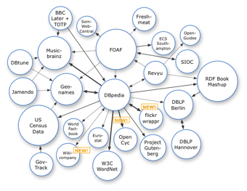
Semantic Web => Linked Open Data
Use Semantic Web Technology to publish shared data & knowledge
2007
Data is inter-
linked to support inte-
gration and fusion of knowledge
LOD beginning

Slide 7
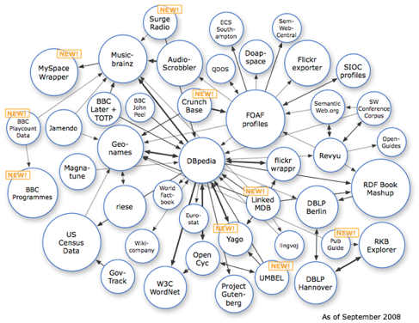
Semantic Web => Linked Open Data
Use Semantic Web Technology to publish shared data & knowledge
2008
Data is inter-
linked to support inte-
gration and fusion of knowledge
LOD growing

Slide 8
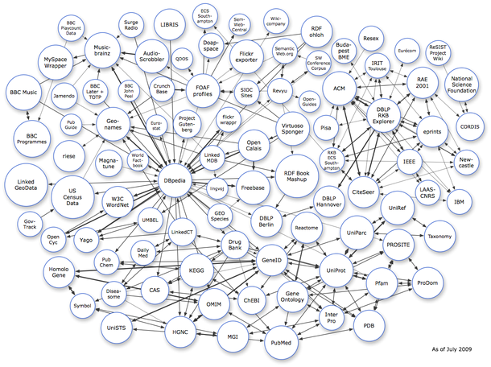
Semantic Web => Linked Open Data
Use Semantic Web Technology to publish shared data & knowledge
2009
Data is inter-
linked to support inte-
gration and fusion of knowledge
… and growing

Slide 9
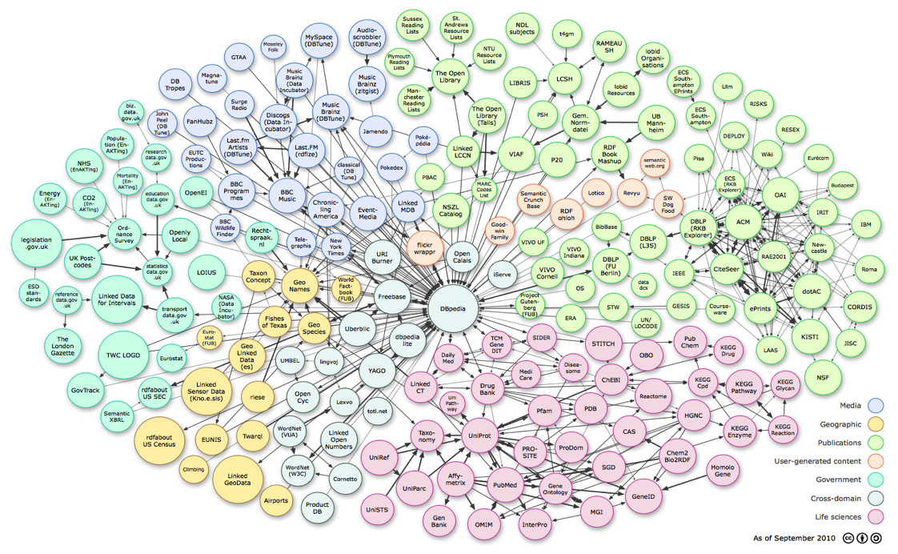
Linked Open Data
Use Semantic Web Technology to publish shared data & knowledge
LOD is the new Cyc: a common source of background
knowledge
Data is inter-
linked to support inte-
gration and fusion of knowledge
2010
…growing faster

Slide 10

Linked Open Data
Use Semantic Web Technology to publish shared data & knowledge
LOD is the new Cyc: a common source of background
knowledge
Data is inter-
linked to support inte-
gration and fusion of knowledge
2011: 31B facts in 295 datasets interlinked by 504M assertions on ckan.net

Slide 11
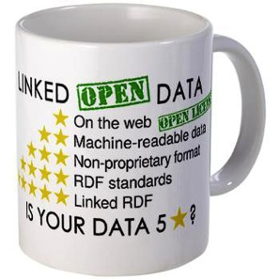
Linked Open Data (LOD)
Linked data is just RDF data, typically just the instances (ABOX), not schema (TBOX)
RDF data is a graph of triples
URI URI string dbr:Barack_Obama dbo:spouse “Michelle Obama”
URI URI URI dbr:Barack_Obama dbo:spouse dbpedia:Michelle_Obama
Best linked data practice prefers the 2nd pattern, using nodes rather than strings for “entities”
Liked open data is just linked data freely accessible on the Web along with any required ontologies

Slide 12
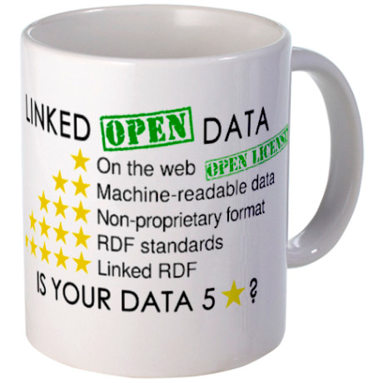
The Linked Data Mug
See Linked Data Rules, Tim Berners-Lee, circa 2006

Slide 13
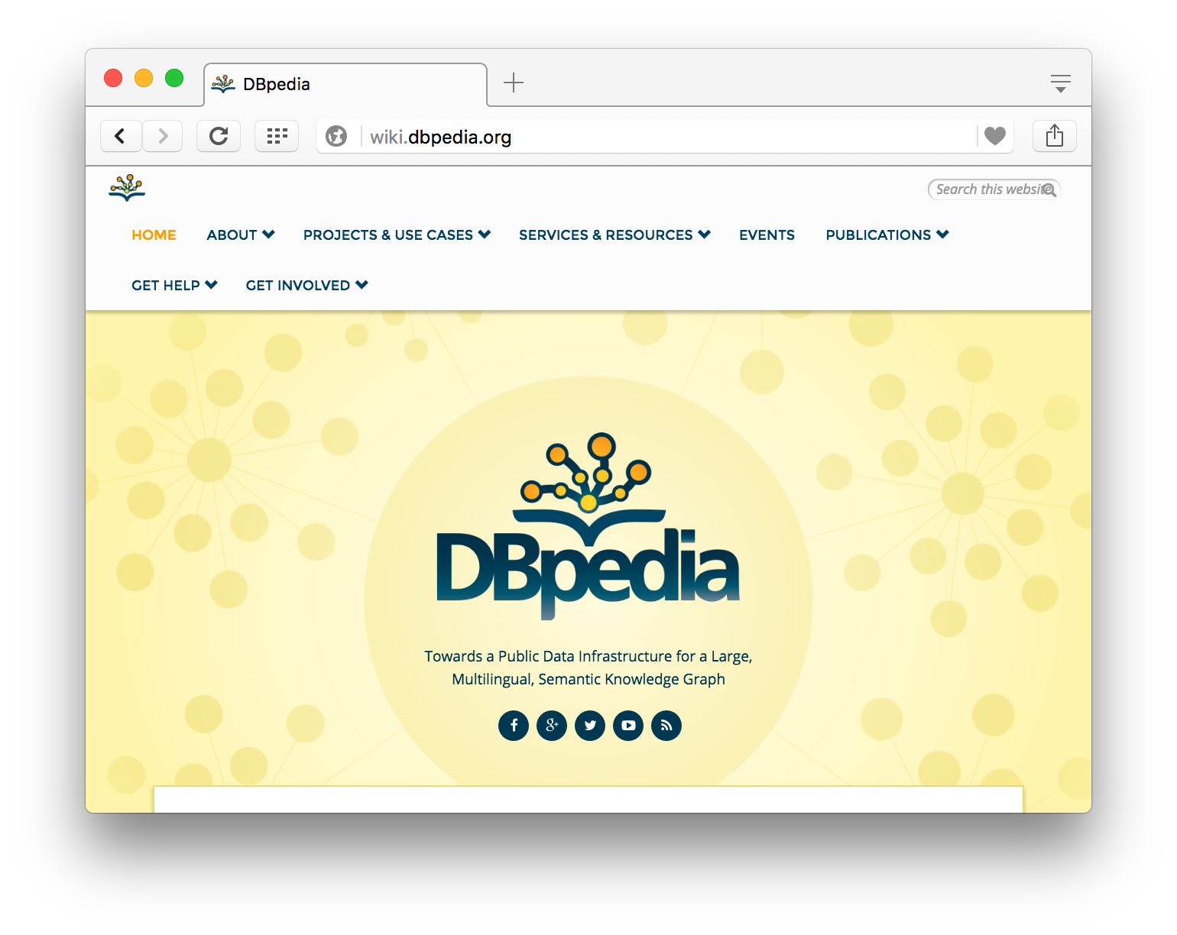
Dbpedia: Wikipedia data in RDF

Slide 14
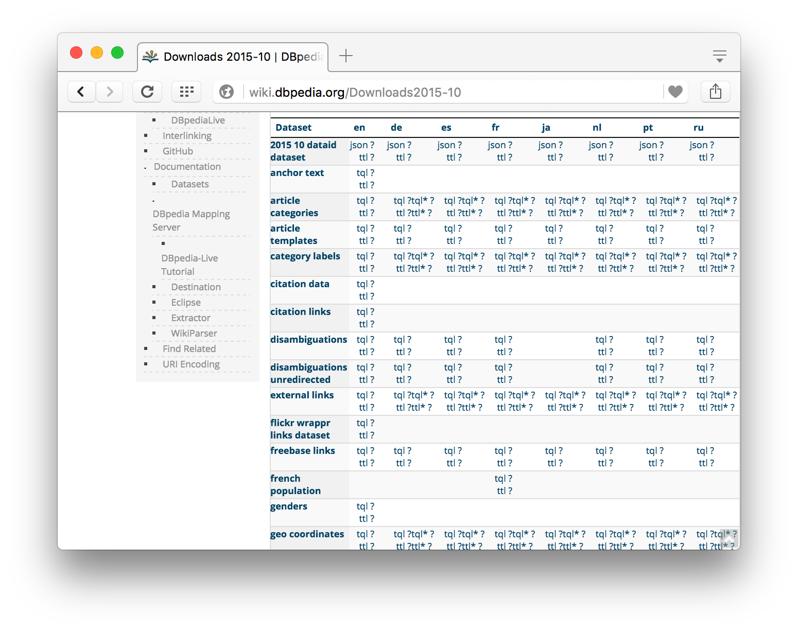
Available for download
Broken up into files by information type
Contains all text, links, infobox data, etc.
Supported by several ontologies
Updated ~ every 3 months
~500M triples for en

Slide 15
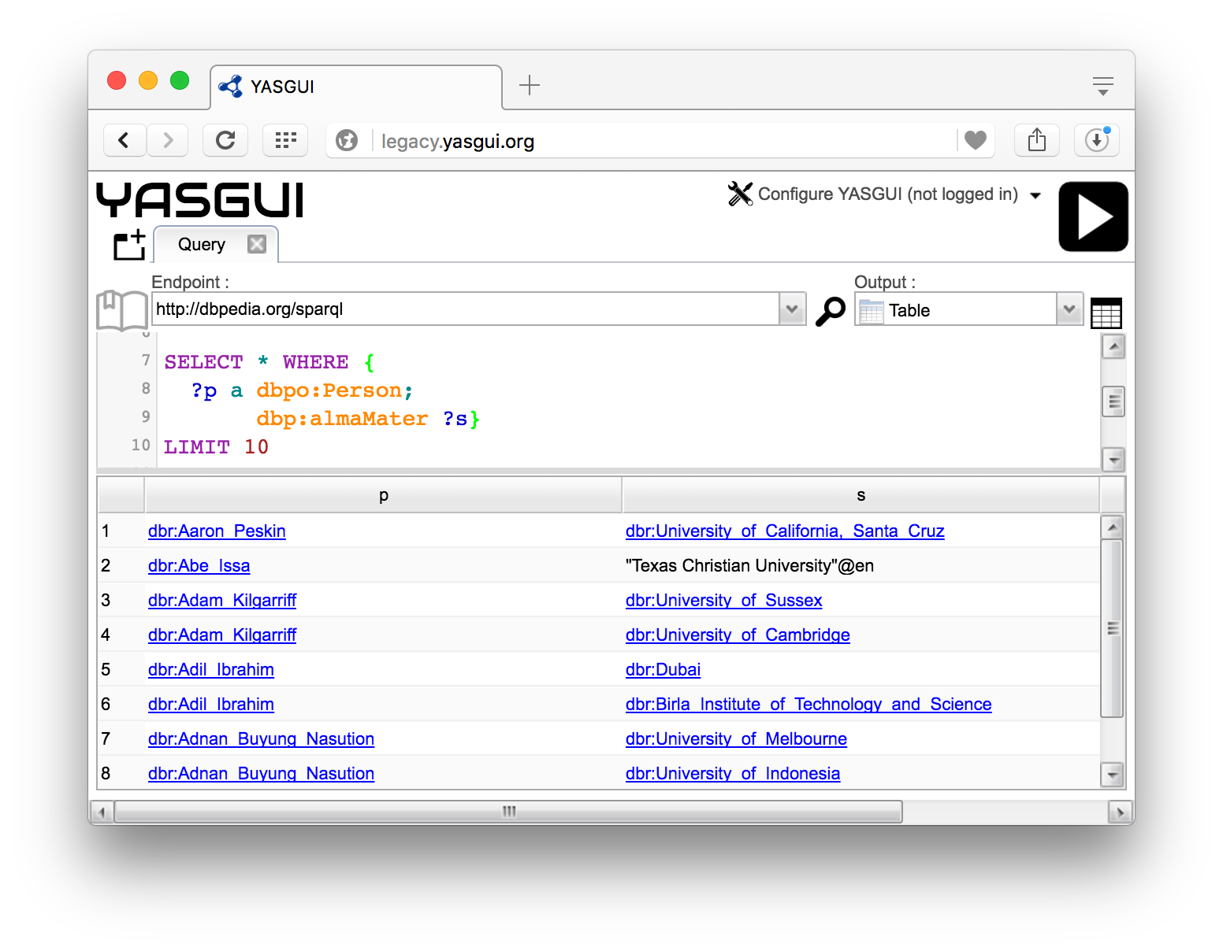
Queryable
You can query any of several RDF triple stores
Or download data, load into a store and query it locally

Slide 16
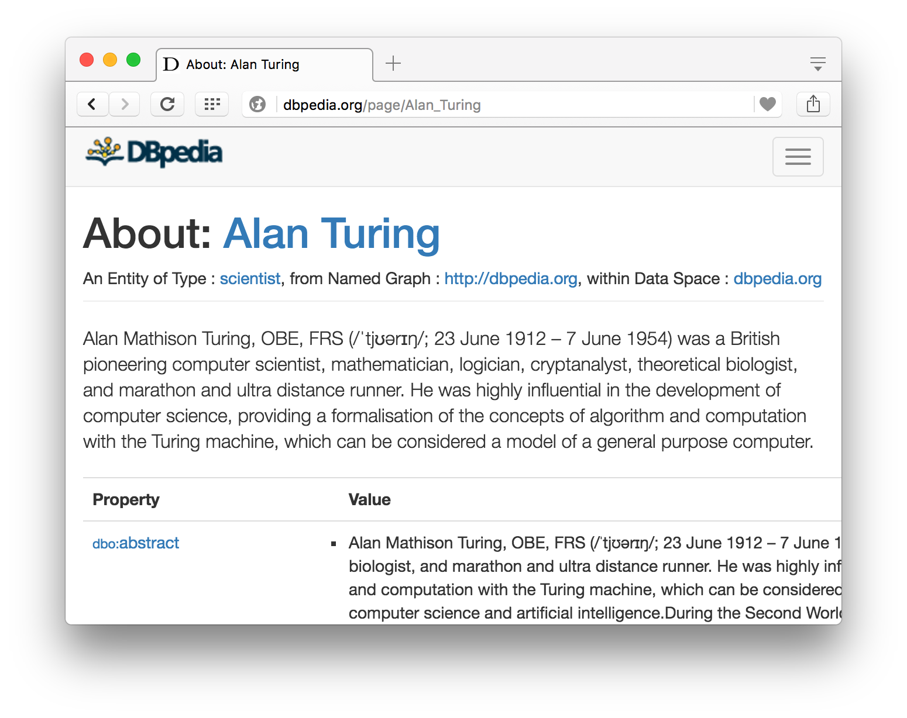
Browseable
There are also RDF browsers
Driven by queries to an RDF triple store loaded with the DBpedia data

Slide 17
Why an RDF Query Language?
Why not use an XML query language?
XML at a lower level of abstraction than RDF
There are various ways of syntactically representing an RDF statement in XML
Thus we’d require several XPath queries, e.g.
//uni:lecturer/uni:title if uni:title element
//uni:lecturer/@uni:title if uni:title attribute
Both XML representations equivalent!

Slide 18
SPARQL
A key to exploiting such large RDF data sets is the SPARQL query language
Sparql Protocol And Rdf Query Language
W3C began developing a spec for a query language in 2004
There were/are other RDF query languages, and extensions, e.g., RQL and Jena’s ARQ
SPARQL a W3C recommendation in 2008 and SPARQL 1.1 in 2013
Most triple stores support SPARQL 1.1

Slide 19
SPARQL Example
PREFIX foaf: <http://xmlns.com/foaf/0.1/>
SELECT ?name ?age
WHERE {
?person a foaf:Person.
?person foaf:name ?name.
?person foaf:age ?age
}
ORDER BY ?age DESC
LIMIT 10
SPARQL uses a Turtle like syntax

Slide 20
SPARQL Protocol, Endpoints, APIs
SPARQL query language
SPROT = SPARQL Protocol for RDF
Among other things specifies how results can be encoded as RDF, XML or JSON
SPARQL endpoint
Service accepts queries, returns results via HTTP
Either generic (fetching data as needed) or specific (querying an associated triple store)
May be a service for federated queries

Slide 21
SPARQL Basic Queries
SPARQL is based on matching graph patterns
Simplest graph pattern is the triple pattern
?person foaf:name ?name
Like an RDF triple, but with variables
Variables begin with a question mark
Combining triple patterns gives a graph pattern; an exact match to a graph is needed
Like SQL, returns a set of results, one for for each way the graph pattern can be instantiated

Slide 22
Turtle Like Syntax
As in Turtle and N3, we can omit a common subject in a graph pattern
PREFIX foaf: <http://xmlns.com/foaf/0.1/>
SELECT ?name ?age
WHERE {
?person a foaf:Person;
foaf:name ?name;
foaf:age ?age
}

Slide 23
Optional Data
Query fails unless the entire pattern matches
We often want to collect information that might not always be available
Note difference with relational model
PREFIX foaf: <http://xmlns.com/foaf/0.1/>
SELECT ?name ?age
WHERE {
?person a foaf:Person;
foaf:name ?name.
OPTIONAL {?person foaf:age ?age}
}

Slide 24
Example of a Generic Endpoint
Use the sparql endpoint at
http://demo.openlinksw.com/sparql
To query graph at
http://ebiq.org/person/foaf/Tim/Finin/foaf.rdf
For foaf knows relations
SELECT ?name ?p2
WHERE { ?person a foaf:Person;
foaf:name ?name;
foaf:knows ?p2. }

Slide 25
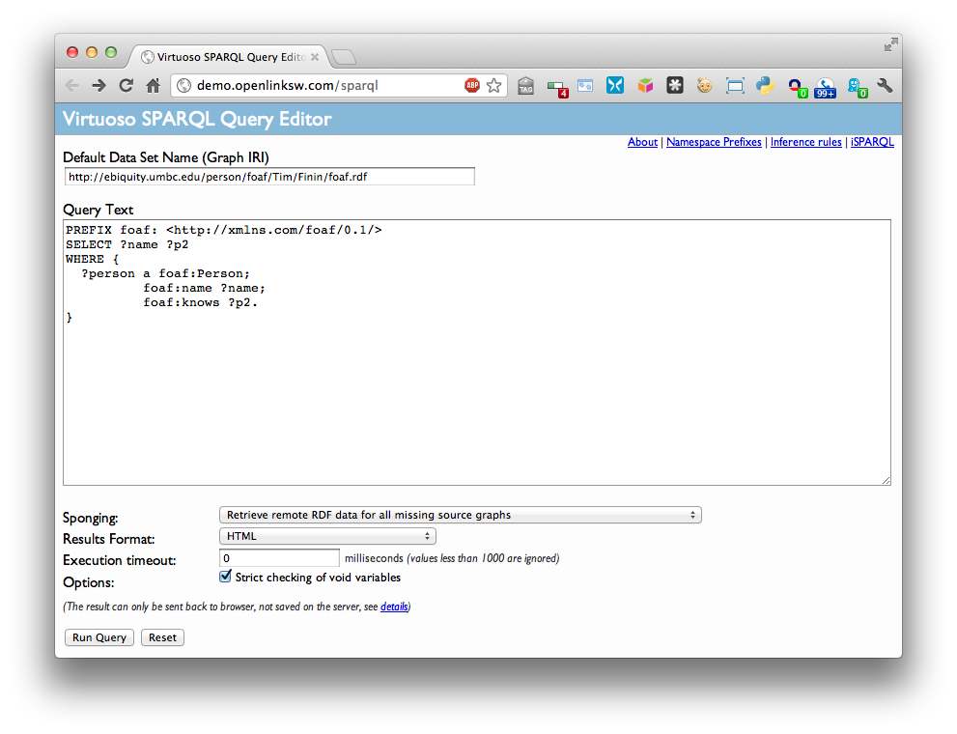
Example

Slide 26
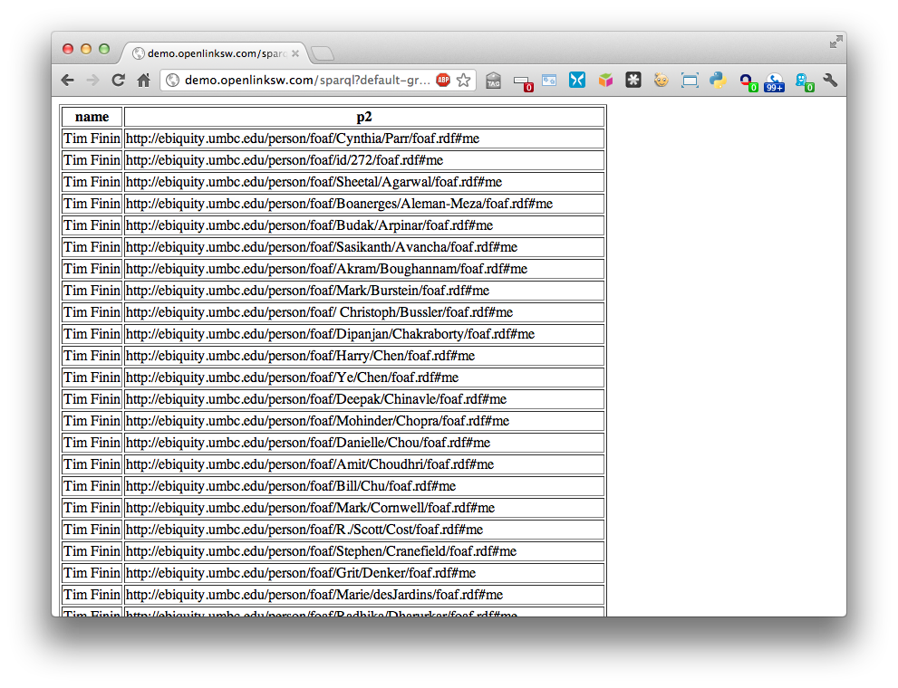
Query results as HTML

Slide 27
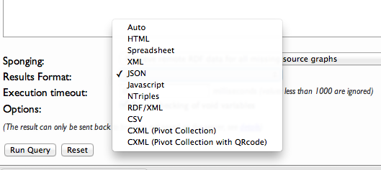
Other result format options

Slide 28
Example of a dedicated Endpoint
Use the sparql endpoint at
http://dbpedia.org/sparql
To query DBpedia
Discover places associated with Pres. Obama
PREFIX dbr: <http://dbpedia.org/resource/>
PREFIX dbo: <http://dbpedia.org/ontology/>
SELECT distinct ?Property ?Place
WHERE {dbr:Barack_Obama ?Property ?Place .
?Place rdf:type dbo:Place .}

Slide 29
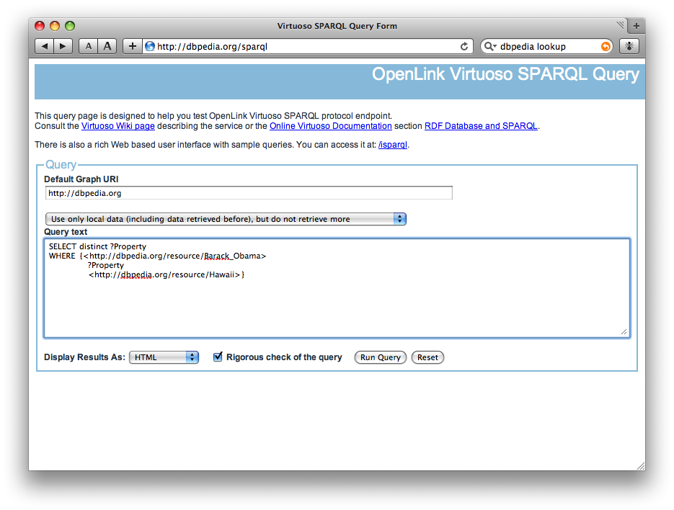
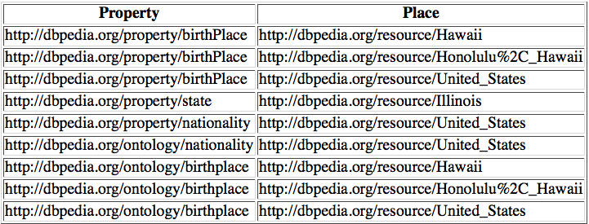
PREFIX dbp: <http://dbpedia.org/resource/>
PREFIX dbpo: <http://dbpedia.org/ontology/>
SELECT distinct ?Property ?Place
WHERE {dbp:Barack_Obama ?Property ?Place .
?Place rdf:type dbpo:Place .}
http://dbpedia.org/sparql/

Slide 30
To use this you must know
Know: RDF data model and SPARQL
Know: Relevant ontology terms and CURIEs for individuals
More difficult than for a typical database because the schema is so large
Possible solutions:
Search for individuals (Plato) to learn IRIs
Browse the KB to learn terms and individual CURIEs
Query using rdf:label and strings

Slide 31
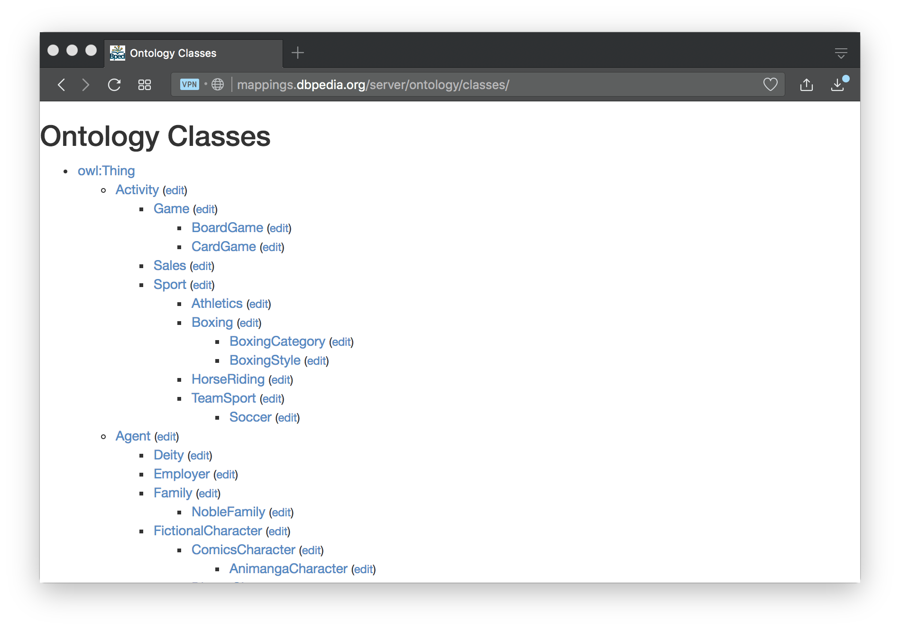
DBpedia Ontology Classes
~ 1000 classes, see http://mappings.dbpedia.org/server/ontology/classes/
http://dbpedia.org/ontology/Boxing

Slide 32
Other classes used in DBpedia
Dbpedia uses classes from other ontologies, including
Yago (> 100K ontologies)
Schema.org
Wikidata
Foaf
Browse DBpedia to discover classes that match your needs

Slide 33
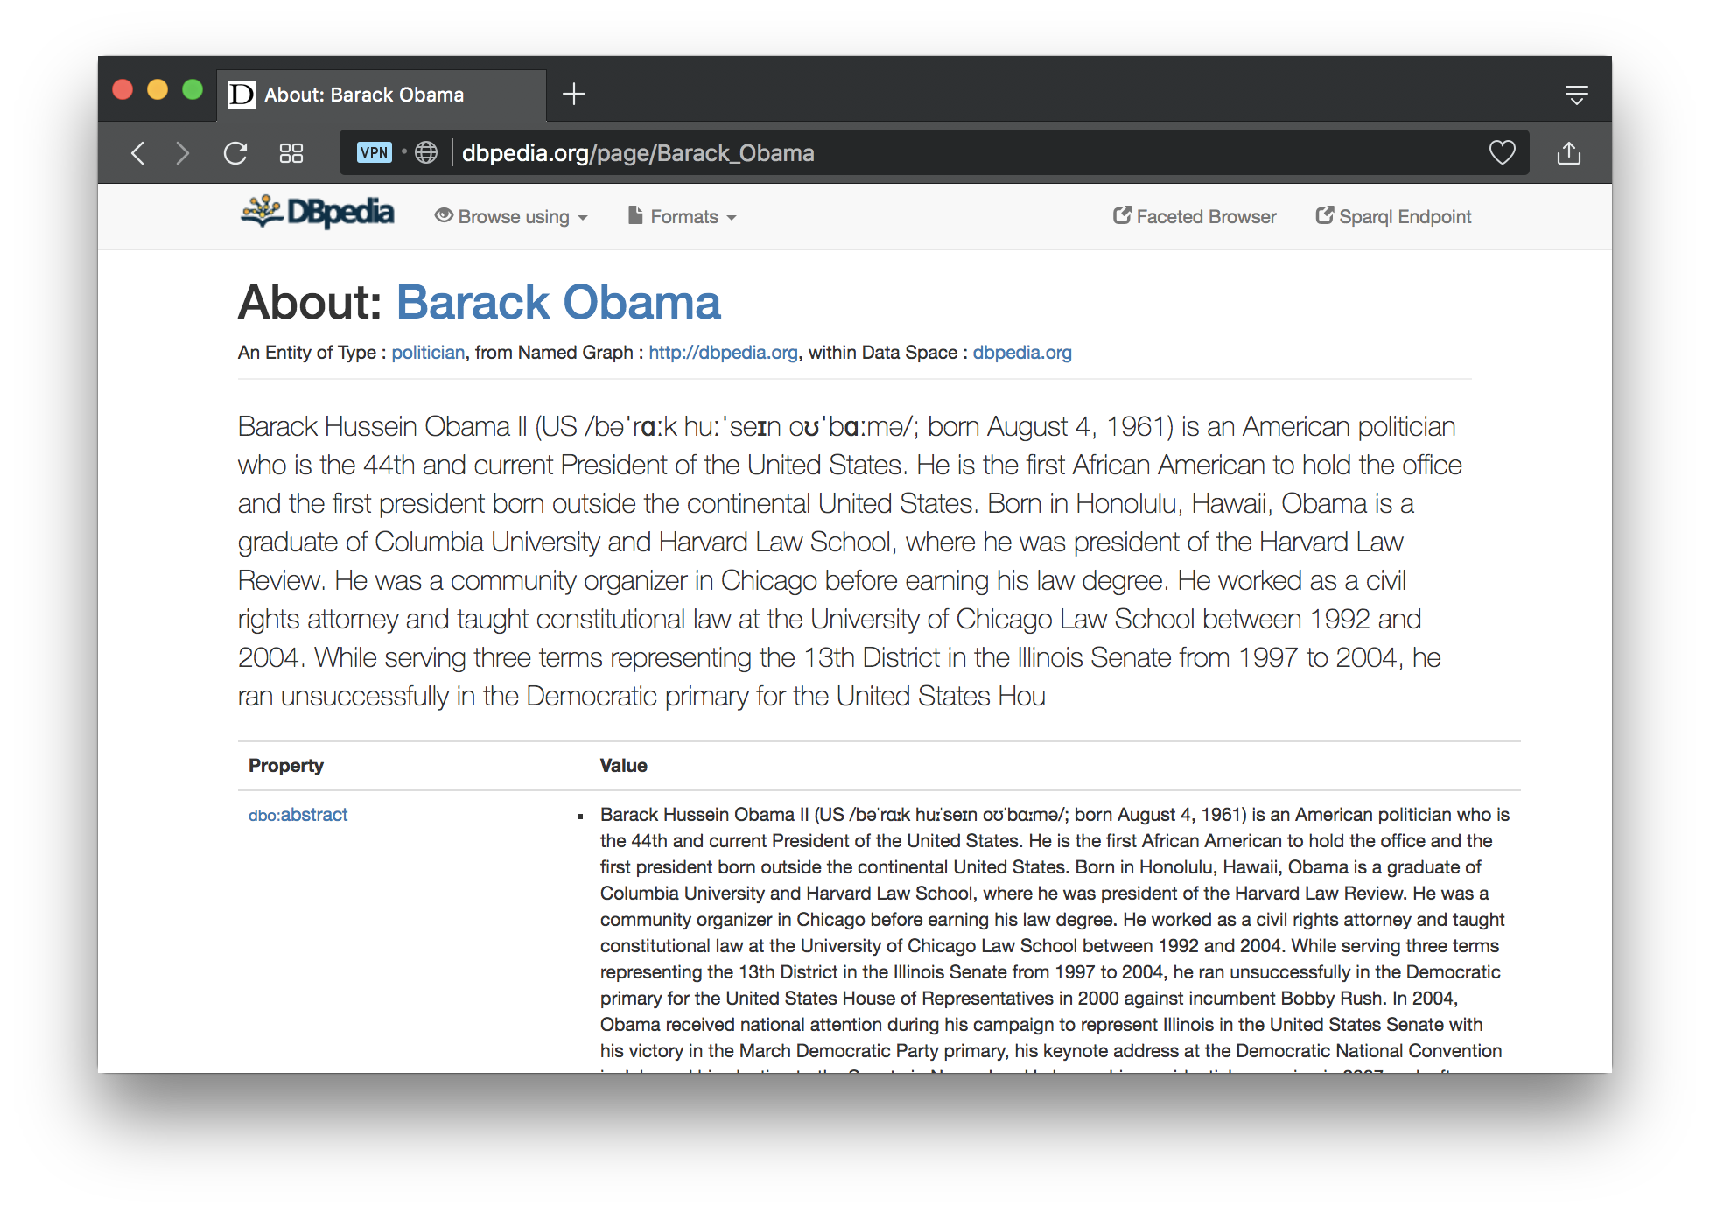
Search for: dbpedia barack obama

Slide 34
Query using labels
PREFIX dbr: <http://dbpedia.org/resource/>
PREFIX dbo: <http://dbpedia.org/ontology/>
PREFIX rdfs: <http://www.w3.org/2000/01/rdf-schema#>
SELECT distinct ?Property ?Place
WHERE {?P a dbo:Person;
rdfs:label "Barack Obama"@en;
?Property ?Place .
?Place rdf:type dbo:Place .}

Slide 35
Query using labels and FILTER
PREFIX dbp: <http://dbpedia.org/resource/>
PREFIX dbpo: <http://dbpedia.org/ontology/>
PREFIX rdfs: <http://www.w3.org/2000/01/rdf-schema#>
SELECT distinct ?P ?Property ?Place
WHERE {?P a dbpo:Person;
rdfs:label ?Name.
FILTER regex(?Name, 'obama', 'i')
?P ?Property ?Place .
?Place rdf:type dbpo:Place .
}

Slide 36
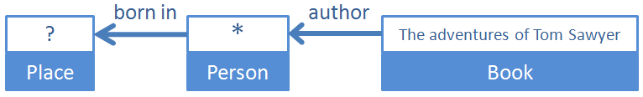
Structured Keyword Queries
Nodes are entities and links binary relations
Entities described by two unrestricted terms: name or value and type or concept
Outputs marked with ?
Compromise between a natural language Q&A system and formal query
Users provide compositional structure of the question
Free to use their own terms to annotate structure

Slide 37
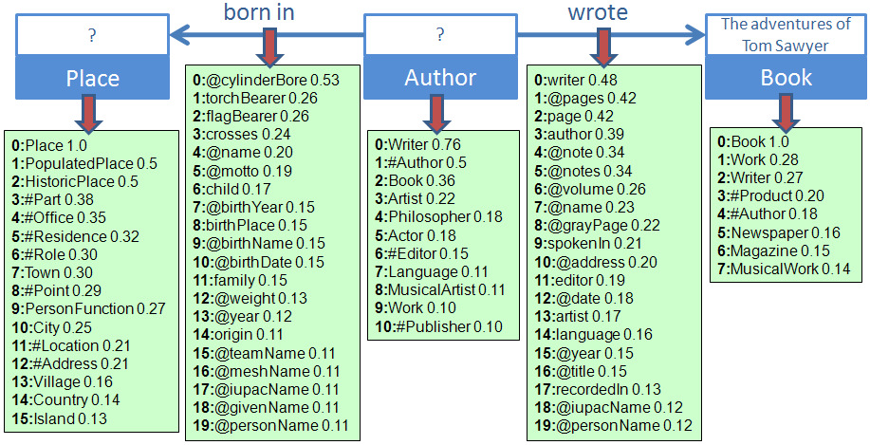
Translation result
Concepts: Place => Place, Author => Writer, Book => Book
Properties: born in => birthPlace, wrote => author (inverse direction)

Slide 38

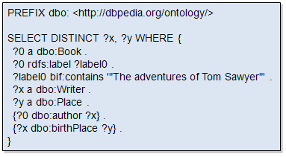
SPARQL Generation
The translation of a semantic graph query to SPARQL is straightforward given the mappings
Concepts
Place => Place
Author => Writer
Book => Book
Relations
born in => birthPlace
wrote => author

Slide 39
SELECT FROM
The FROM clause lets us specify the target graph in the query
SELECT * returns all
PREFIX foaf: <http://xmlns.com/foaf/0.1/>
SELECT *
FROM <http://ebiq.org/person/foaf/Tim/Finin/foaf.rdf>
WHERE {
?P1 foaf:knows ?p2
}

Slide 40
FILTER
Find landlocked countries with a population >15 million
PREFIX rdfs: <http://www.w3.org/2000/01/rdf-schema#>
PREFIX yago: <http://dbpedia.org/class/yago/>
PREFIX dbp: <http://dbpedia.org/property/>
SELECT ?country_name ?population
WHERE {
?country a yago:LandlockedCountries ;
rdfs:label ?country_name ;
dbp:populationEstimate ?population .
FILTER (?population > 15000000) .
}

Slide 41
FILTER Functions
Logical: !, &&, ||
Math: +, -, *, /
Comparison: =, !=, >, <, ...
SPARQL tests: isURI, isBlank, isLiteral, bound
SPARQL accessors: str, lang, datatype
Other: sameTerm, langMatches, regex
Conditionals (SPARQL 1.1): IF, COALESCE
Constructors (SPARQL 1.1): URI, BNODE, STRDT, STRLANG
Strings (SPARQL 1.1): STRLEN, SUBSTR, UCASE, …
More math (SPARQL 1.1): abs, round, ceil, floor, RAND
Date/time (SPARQL 1.1): now, year, month, day, hours, …
Hashing (SPARQL 1.1): MD5, SHA1, SHA224, SHA256, …

Slide 42
Union
UNION keyword forms disjunction of two graph patterns
Both subquery results are included
PREFIX foaf: <http://xmlns.com/foaf/0.1/>
PREFIX vCard: <http://www.w3.org/2001/vcard-rdf/3.0#>
SELECT ?name
WHERE
{
{ [ ] foaf:name ?name } UNION { [ ] vCard:FN ?name }
}

Slide 43
Query forms
Each form takes a WHERE block to restrict the query
SELECT: Extract raw values from a SPARQL endpoint, the results are returned in a table format
CONSTRUCT: Extract information from SPARQL endpoint and transform the results into valid RDF
ASK: Returns a simple True/False result for a query on a SPARQL endpoint
DESCRIBE Extract RDF graph from endpoint, the contents of which is left to the endpoint to decide based on what maintainer deems as useful information

Slide 44
SPARQL 1.1
SPARQL 1.1 includes
Updated 1.1 versions of SPARQL Query and SPARQL Protocol
SPARQL 1.1 Update
SPARQL 1.1 Graph Store HTTP Protocol
SPARQL 1.1 Service Descriptions
SPARQL 1.1 Entailments
SPARQL 1.1 Basic Federated Query

Slide 45
Summary
An important usecase for RDF is exploiting large collections of semi-structured data, e.g., the linked open data cloud
We need a good query language for this
SPARQL is the SQL of RDF
SPARQL is a language to query and update triples in one or more triples stores
It’s key to exploiting Linked Open Data

